Slide 2
基于DC/OS的现代应用 实践
Sam Chen
2016.10

Slide 3

个人简介
DC/OS中国社区创始人和社区项目孵化者。
陈冉(Sam)先生曾任职Linker Networks首席技术官和技术副总裁，主要负责Linker 的技术路线制定，新技术孵化和产品线推广。在这之前，在惠普云事业部担任首席架构师和首席技术官。
Mesos/OpenStack/Docker/CF社区共同负责人。
OSCAR DCOS PL/Core。
开源布道者。
Linux 基金会中国协调人

Slide 4
演讲内容
概念解释
微服务
现代应用
DC/OS是什么
DC/OS vs. Docker vs. K8S vs. Openstack
如何现实现代应用在DC/OS架构
DC/OS为什么“与众不同”
落地最佳实践
案例分析

Slide 5
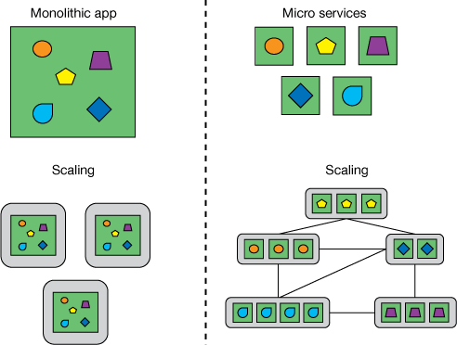
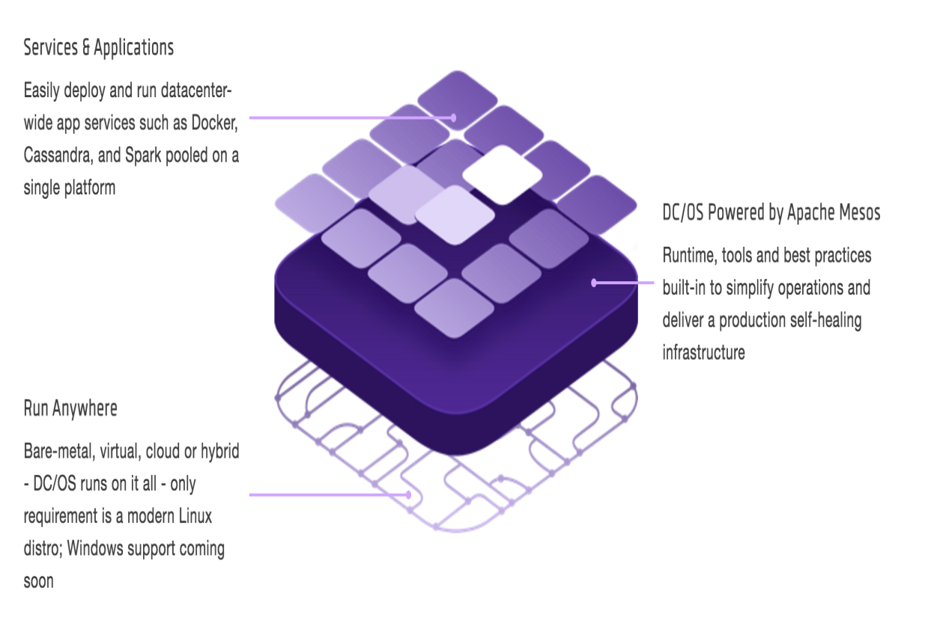
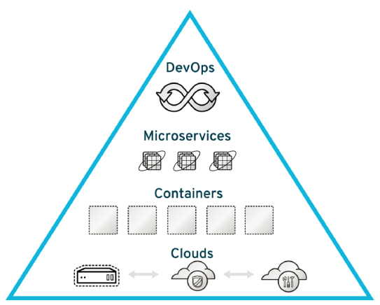
概念介绍
Modern Apps= (DC/OS ＋Micro services +CI/CD + Hybrid Cloud)
Modern Apps= (DC/OS ＋Micro services +CI/CD + Hybrid Cloud)

Slide 6
微服务要素
The Twelve Factors
Code Base
One codebase tracked in revision control, many deploys
Port Binding
Export services via port binding
Dependences
Explicitly declare and isolate dependences
Concurrency
Scale out via process model
Config
Store config in environment
Disposability
Maximize robustness with fast startup and graceful shutdown
Backing Services
Treat backing services as attached resources
10. Dev/prod parity
Keep development, staging, and production as similar as possible
Build, release, run
Strictly separate build and run stages
11. Logs
Treat logs as event stream
Process
Execute the app as one or more stateless processes
12. Admin processes
Run admin/management tasks as one-off processes

Slide 7
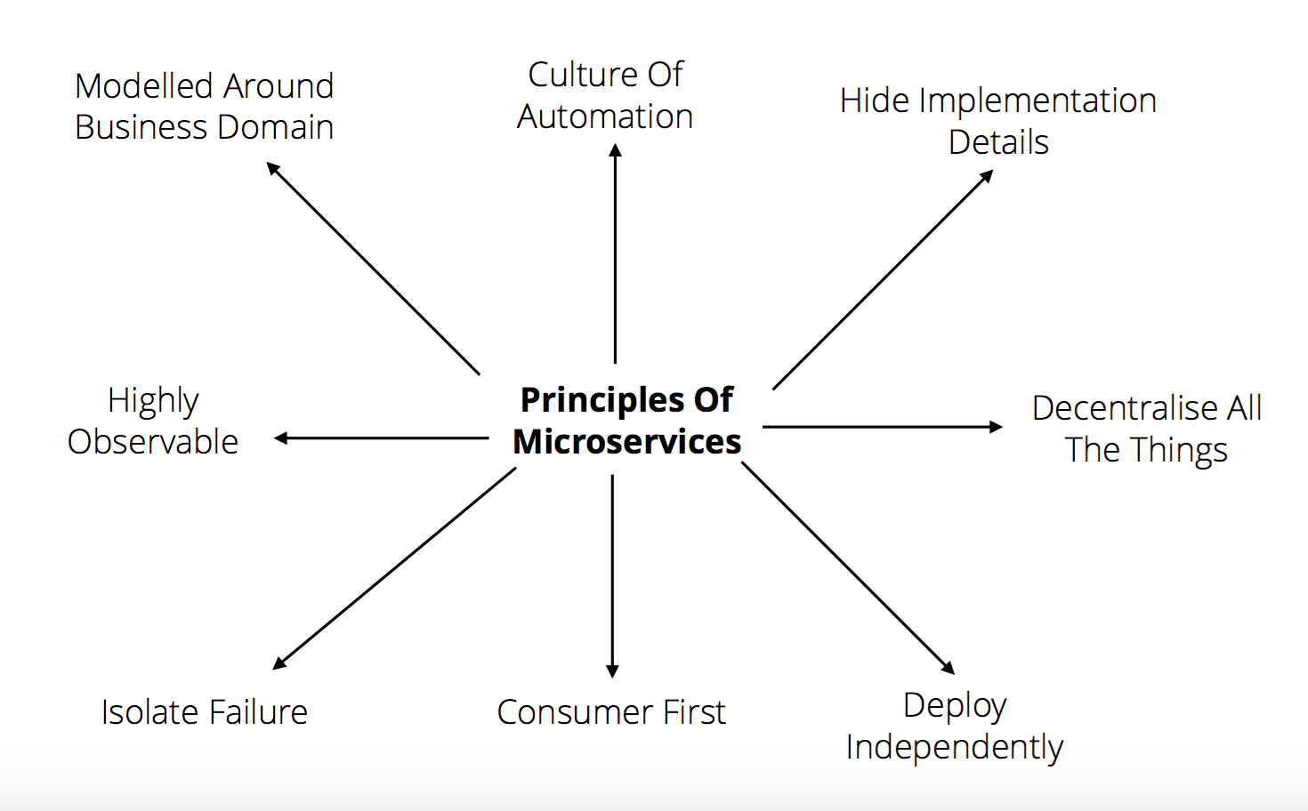
微服务准则

Slide 8




什么是现代应用
UNIT OF INTERACTION
NEW FORM FACTOR FOR DEVELOPING AND RUNNING APPS
PARTITION (LPAR)
SERVER
VIRTUAL MACHINE
???
DATACENTER
MAINFRAME
PHYSICAL (x86)
VIRTUAL
HYPERSCALE
BIG DATA, INTERNET OF THINGS, MOBILE APPS
???
DATA / TRANSACTION PROCESSING
UNIX, IBM OS/360
ERP, CRM, PRODUCTIVITY, MAIL & WEB SERVER
LINUX, WINDOWS
ERP, CRM, PRODUCTIVITY, MAIL & WEB SERVER
HYPERVISOR + GUEST OS
BIG DATA, INTERNET OF THINGS, MOBILE APPS
DATACENTER OPERATING SYSTEM (DC/OS)
DEFINITIVE
APPS AND OS

Slide 9
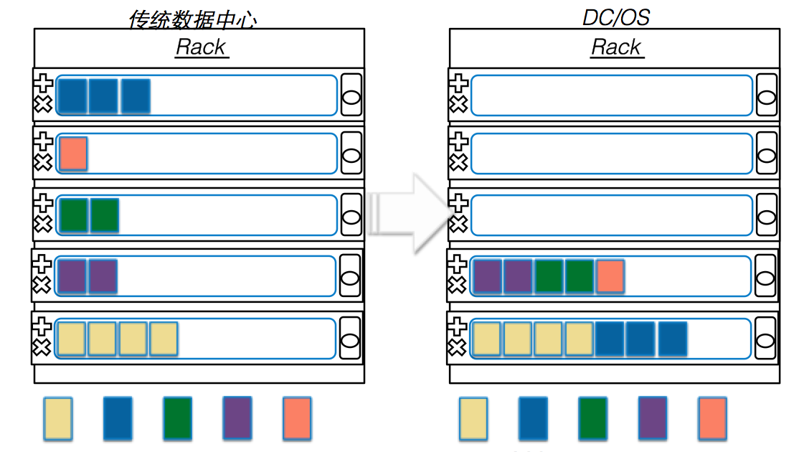

DC/OS是什么
Colorful rectangles are any distributed services
running on pre-allocated servers
with characteristics of low resource utilization andcomplicated operation management
DC/OS maximizing resource utilization with
higher availability, elasticity and robust in fabric
and aggregated datacenter

Slide 10
DC/OS与现代应用
100% 开源(ASL2.0) ＋ 一个生态＋一个多元化的社区
在此之下有 ~30 OSS 项目＋ 路线图和设计 + The build tool chain ＋Docs and tutorials ＋ Not limited in any way
现代应用部件
微服务(in containers)
大数据+ 分析引擎
Streaming
Ecosystem of frameworks & apps
Consistent architecture to run on top of kernel
Batch
分析
功能& 逻辑
Machine Learning
Search
数据库
User Interface (GUI & CLI)
Core system services (e.g., distributed init, cron, service discovery, package mgt & installer, storage)
Time Series
SQL / NoSQL
Datacenter Operating System (DC/OS)
Distributed systems kernel to abstract resources
Distributed Systems Kernel (Mesos)
Any Infrastructure (Physical, Virtual, Cloud)

Slide 11
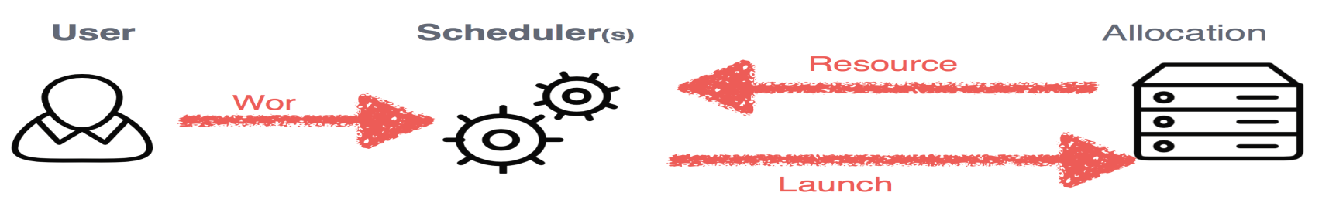
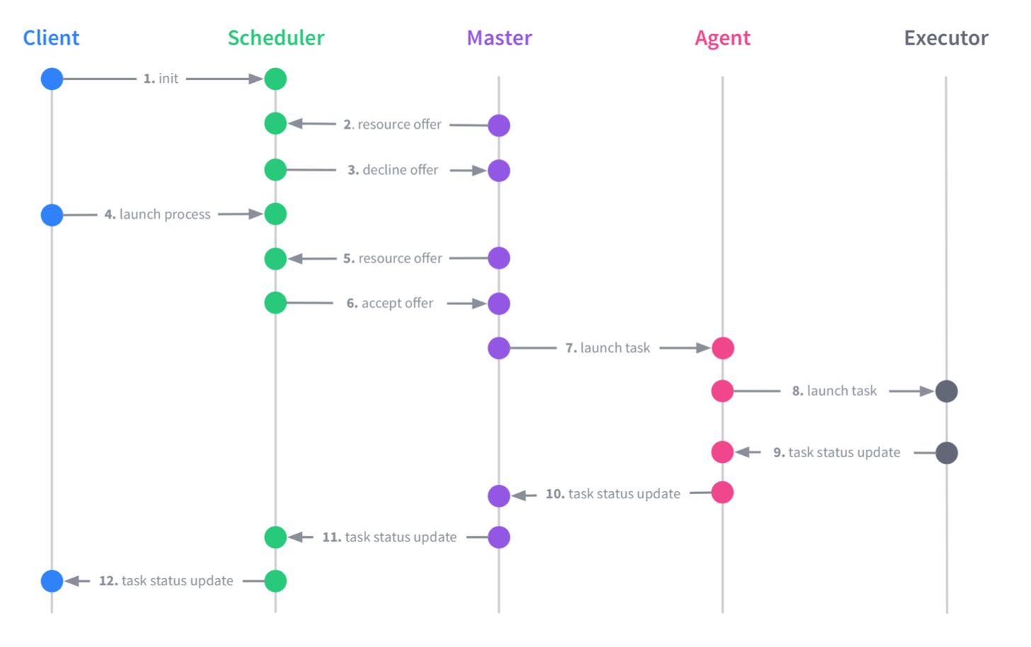
DC/OS在现代应用中的优势

Slide 12
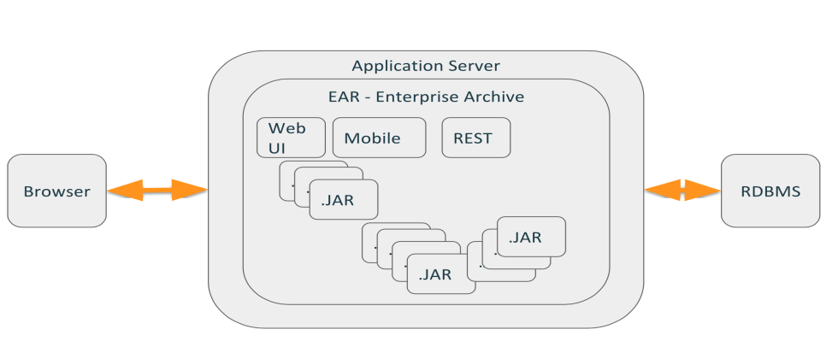
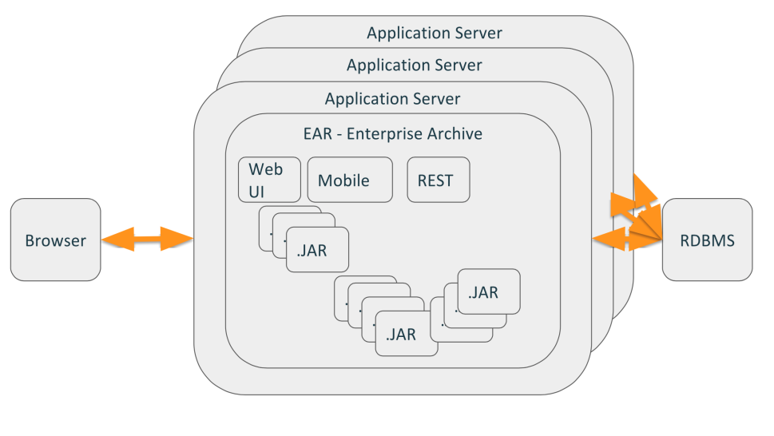
传统应用现状
Monolithic application – everything is package into a single .ear
Reuse primarily by sharing .jars
A “big” push to production once or twice a year
Single database schema for the entire application
>= Heavyweight Infrastructure
Thousands of Testcases
Barely New Testcases
>= 20 Team Member
The single .ear requiring a multi-month test cycle /
Huge bug and feature databases
User Acceptance Undefined
Technical Design Approach
Barely Business Components or Domains
Requiring multiple team involvement & significant oversight
Technical Dept
Grown applications
Outdated Runtimes (Licenses, Complex
Updates）

Slide 13

传统应用新需求
研发部门期待缩短从开发到产品的生命周期，更好服务公司业务降低风险；
激烈竞争的商业市场下，GTM期待传统应用快速演进，能够满足市场需求；
前端部门对终端用户的无间断，高可靠性的服务要求不断加强，提供竞争力；
在IT和数据中心上的费用不断攀升，期待降低运维和运营成本；
传统企业期待业务系统能够根据Data的分析，从而持续修正自己；

Slide 14
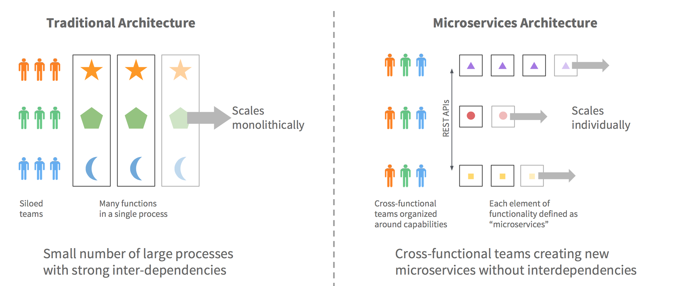
传统应用>>>现代应用

Slide 15
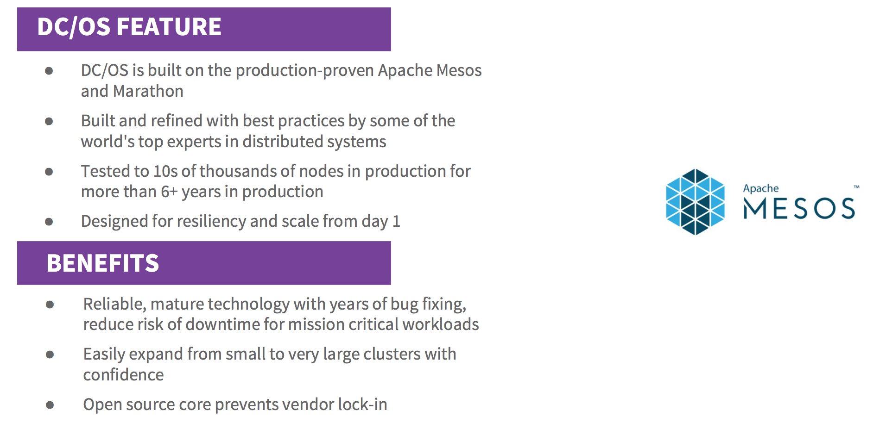
生产环境验证过的伸缩性

Slide 16
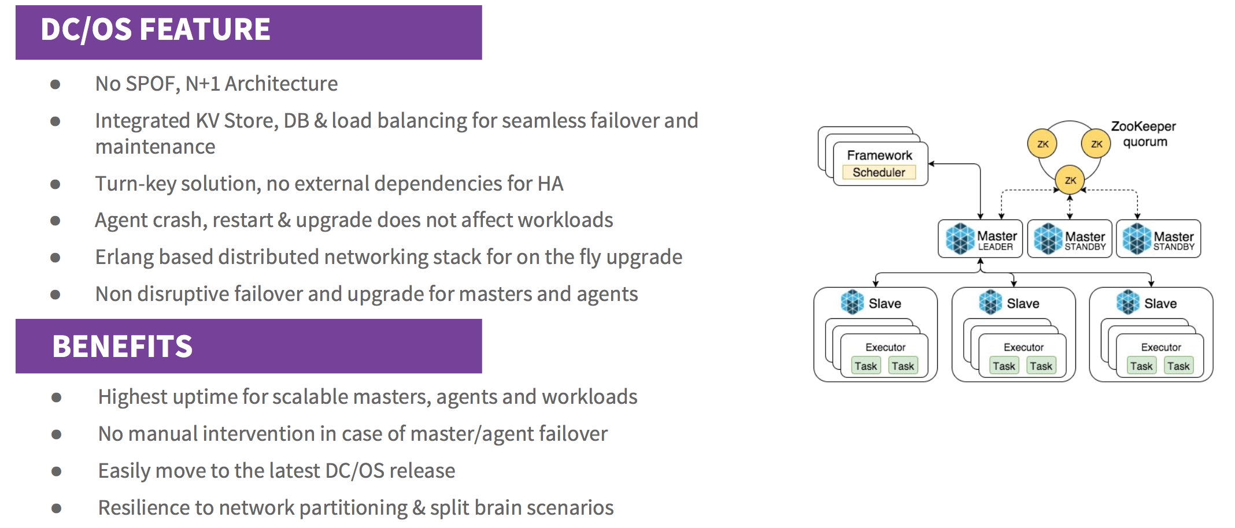
现代应用分布式高可用性

Slide 17
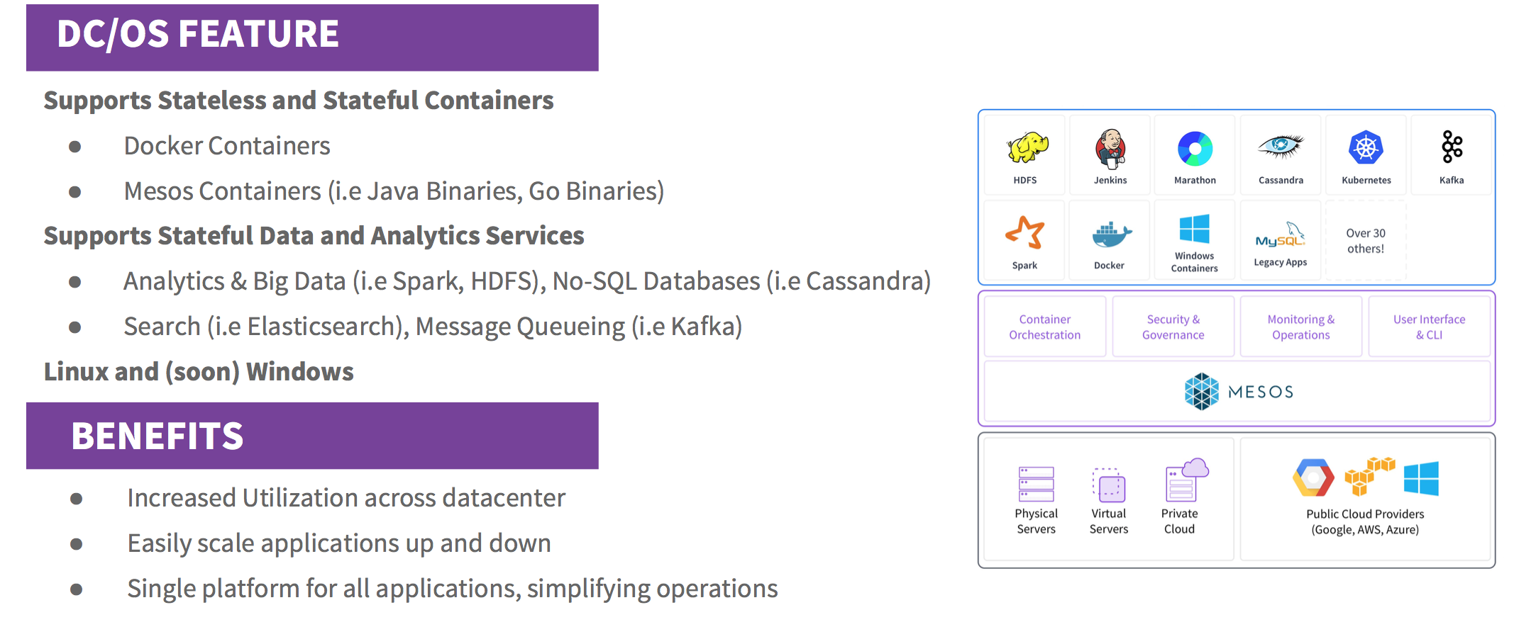
容器和数据服务

Slide 18
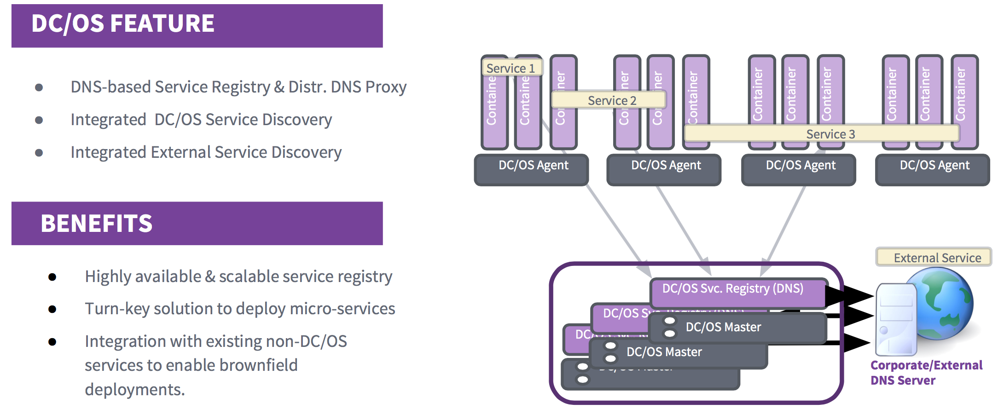
服务发现

Slide 19
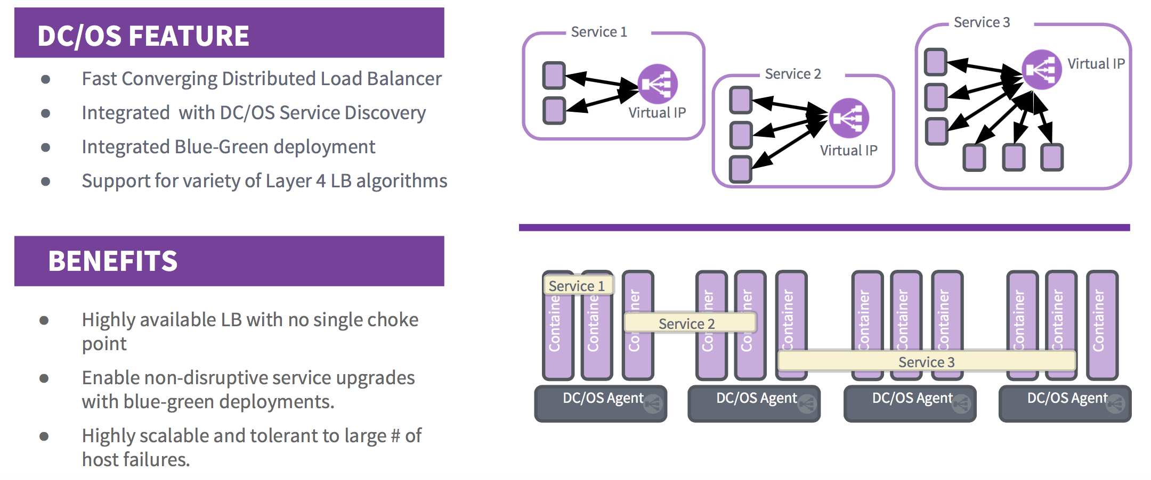
可靠性－L4 LB

Slide 20
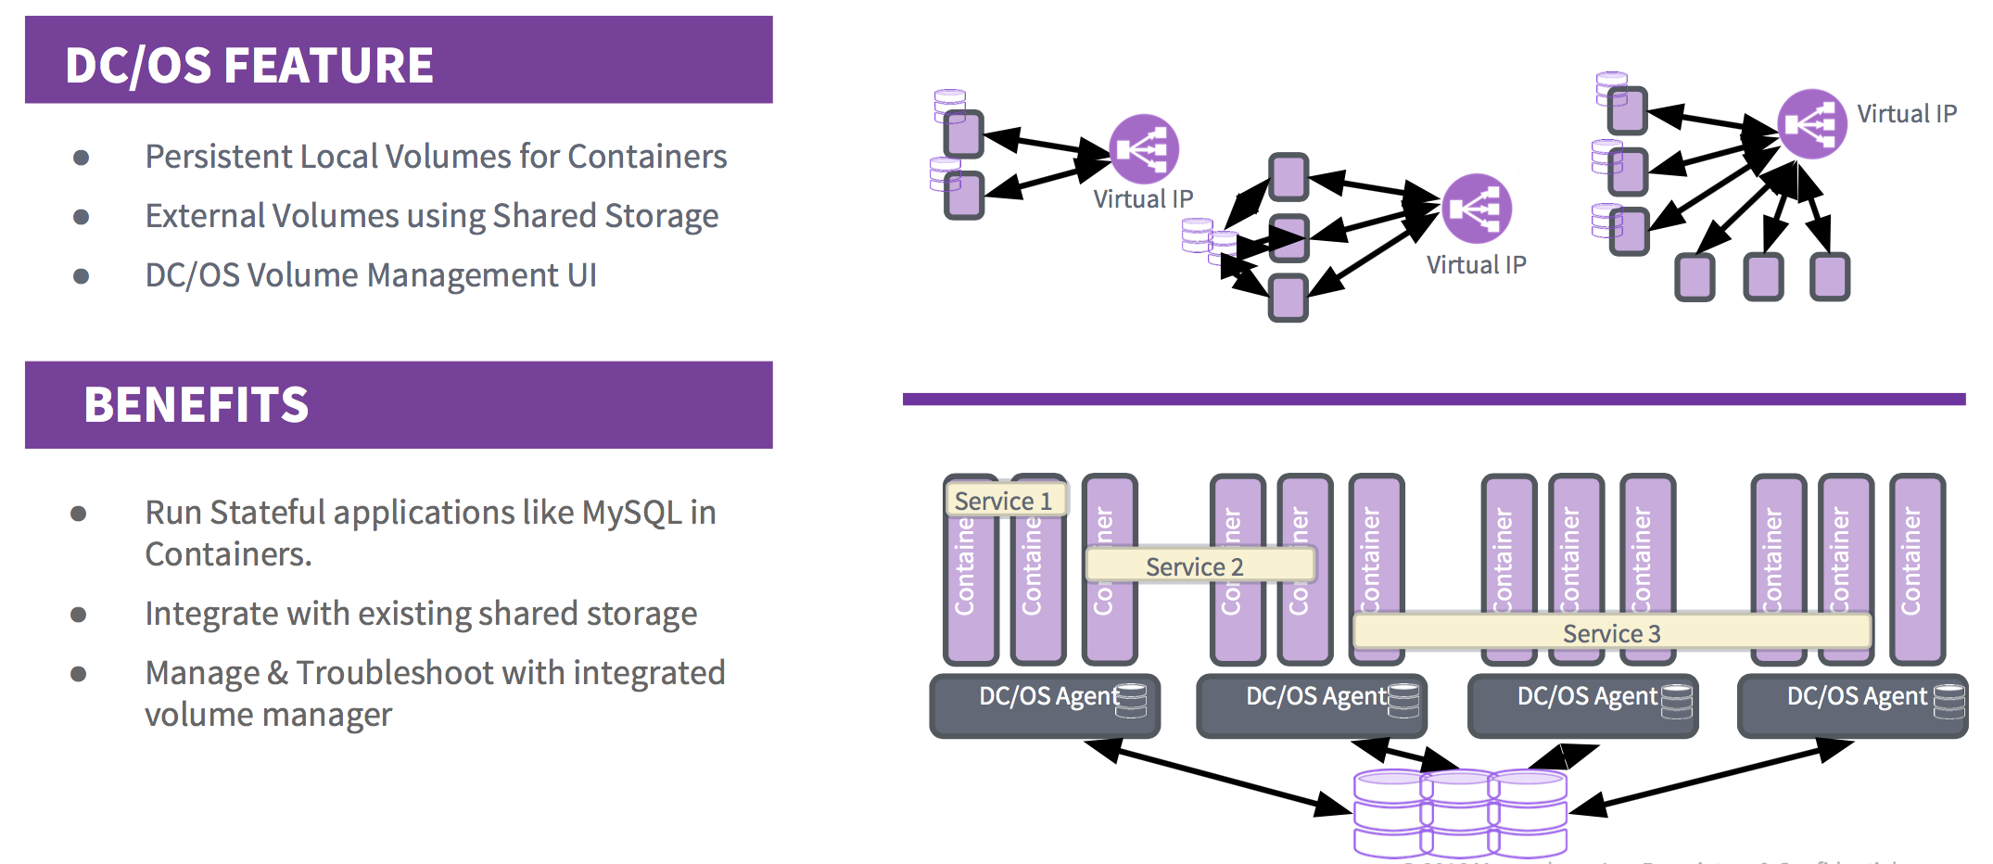
有状态容器和卷

Slide 21
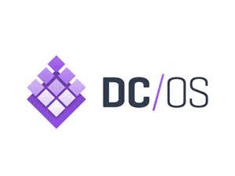


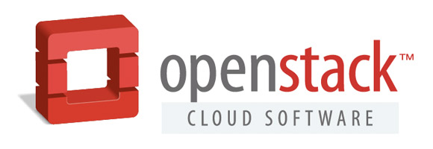
“三国杀”+？

Slide 22
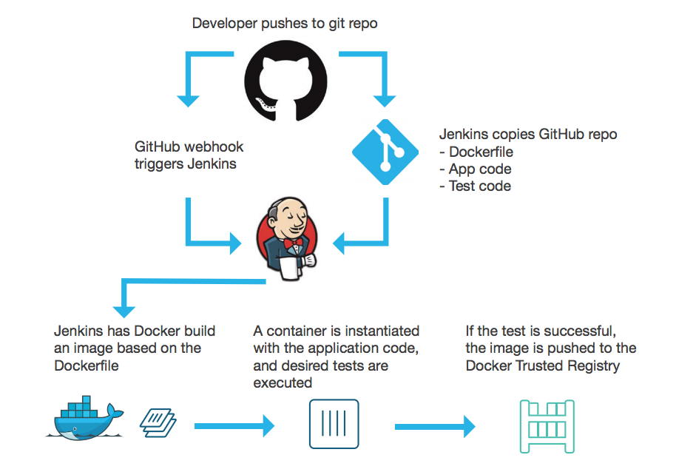
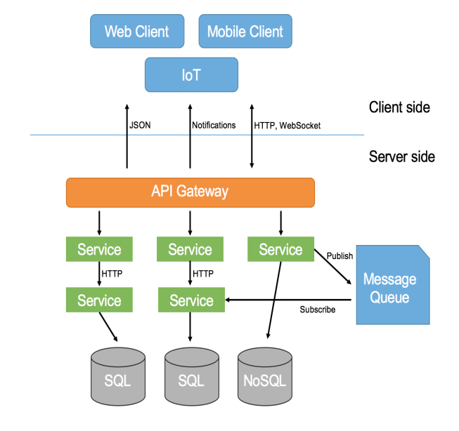
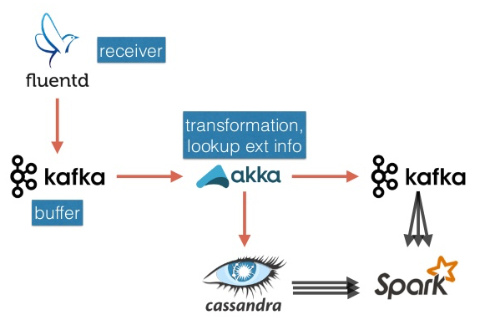

现代架构最佳实践
1
2
3

Slide 23
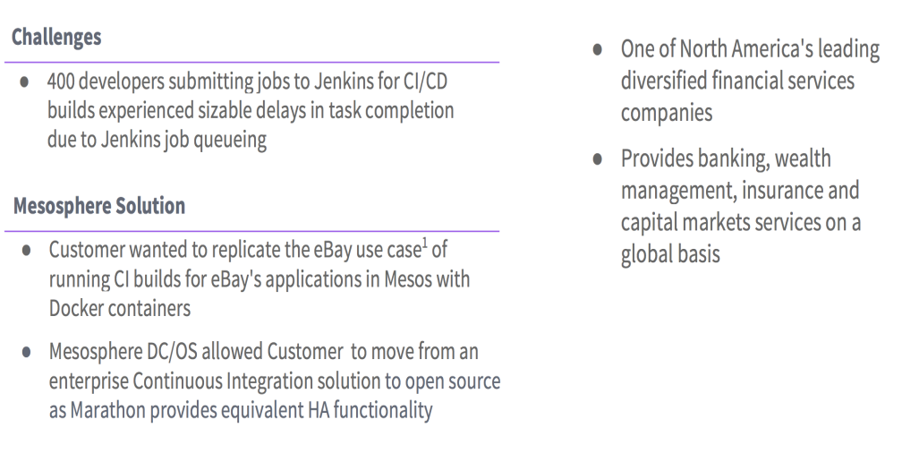
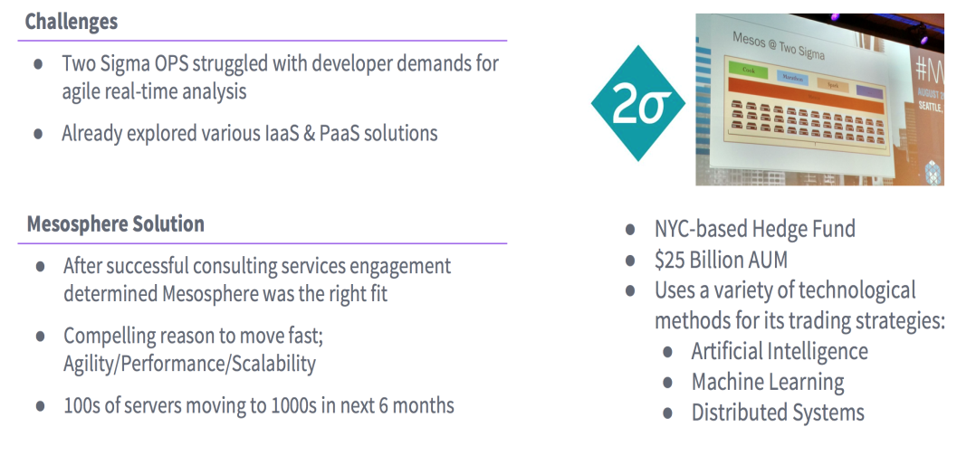
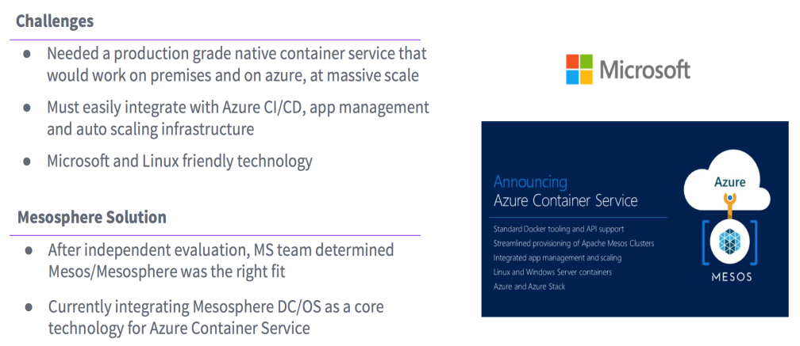
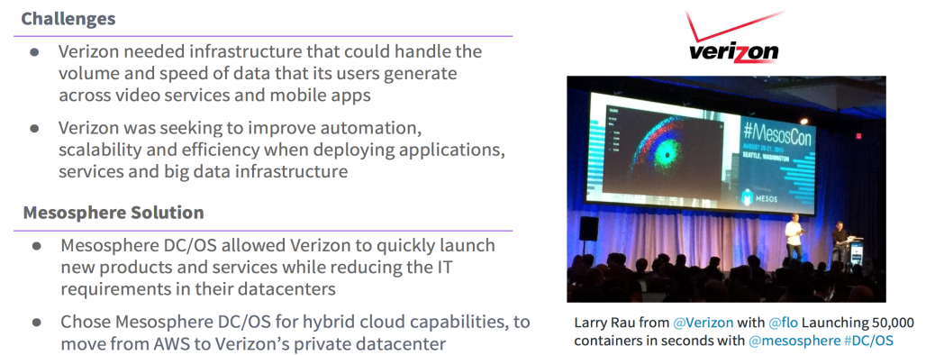
案例分享一

Slide 24
案例分享二
电信运营商
银行
互联网公司
保险
车联网

Slide 25
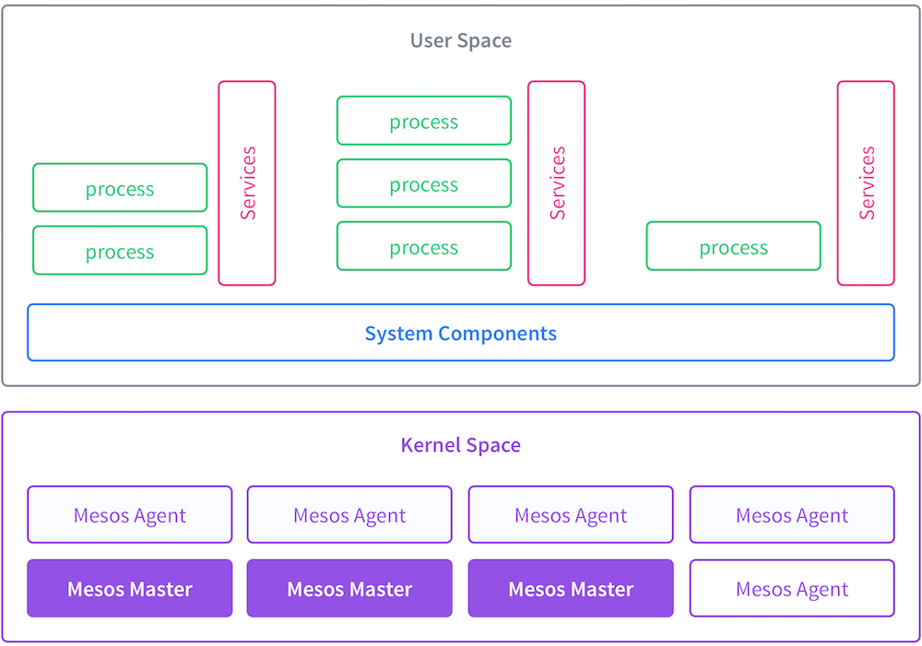
DC/OS服务集
System Components are installed and are running by default in the DC/OS cluster and include the following:
The Admin Router is an open source NGINX configuration that provides central authentication and proxy to DC/OS services.
Exhibitor automatically configures ZooKeeper during installation and provides a usable Web UI to ZooKeeper.
Mesos-DNS provides service discovery, allowing apps and services to find each other by using the domain name system (DNS).
Minuteman is the internal layer 4 load balancer.
Distributed DNS Proxy is the internal DNS dispatcher.
DC/OS Marathon, the native Marathon instance that is the ‘init system’ for DC/OS, starts and monitors DC/OS services.
ZooKeeper, a high-performance coordination service that manages the DC/OS services.
The Cosmos service is our internal packaging API service.
The diagnostics service (also known as 3DT or dcos-ddt.service, no relationship to the pesticide!) is our diagnostics utility for DC/OS systemd components.
Logrotate service does what you think it does: ensures DC/OS services don’t blow up cluster hosts with too much log data on disk.
Marathon shouldn’t need any introduction, it’s the distributed init system for the DC/OS cluster.
The DC/OS signal service queries the diagnostics service /system/health/v1/report endpoint on the leading master and sends this data to SegmentIO for use in tracking metrics and customer support.
The history service provides a simple service for storing stateful information about your DC/OS cluster.

Slide 26
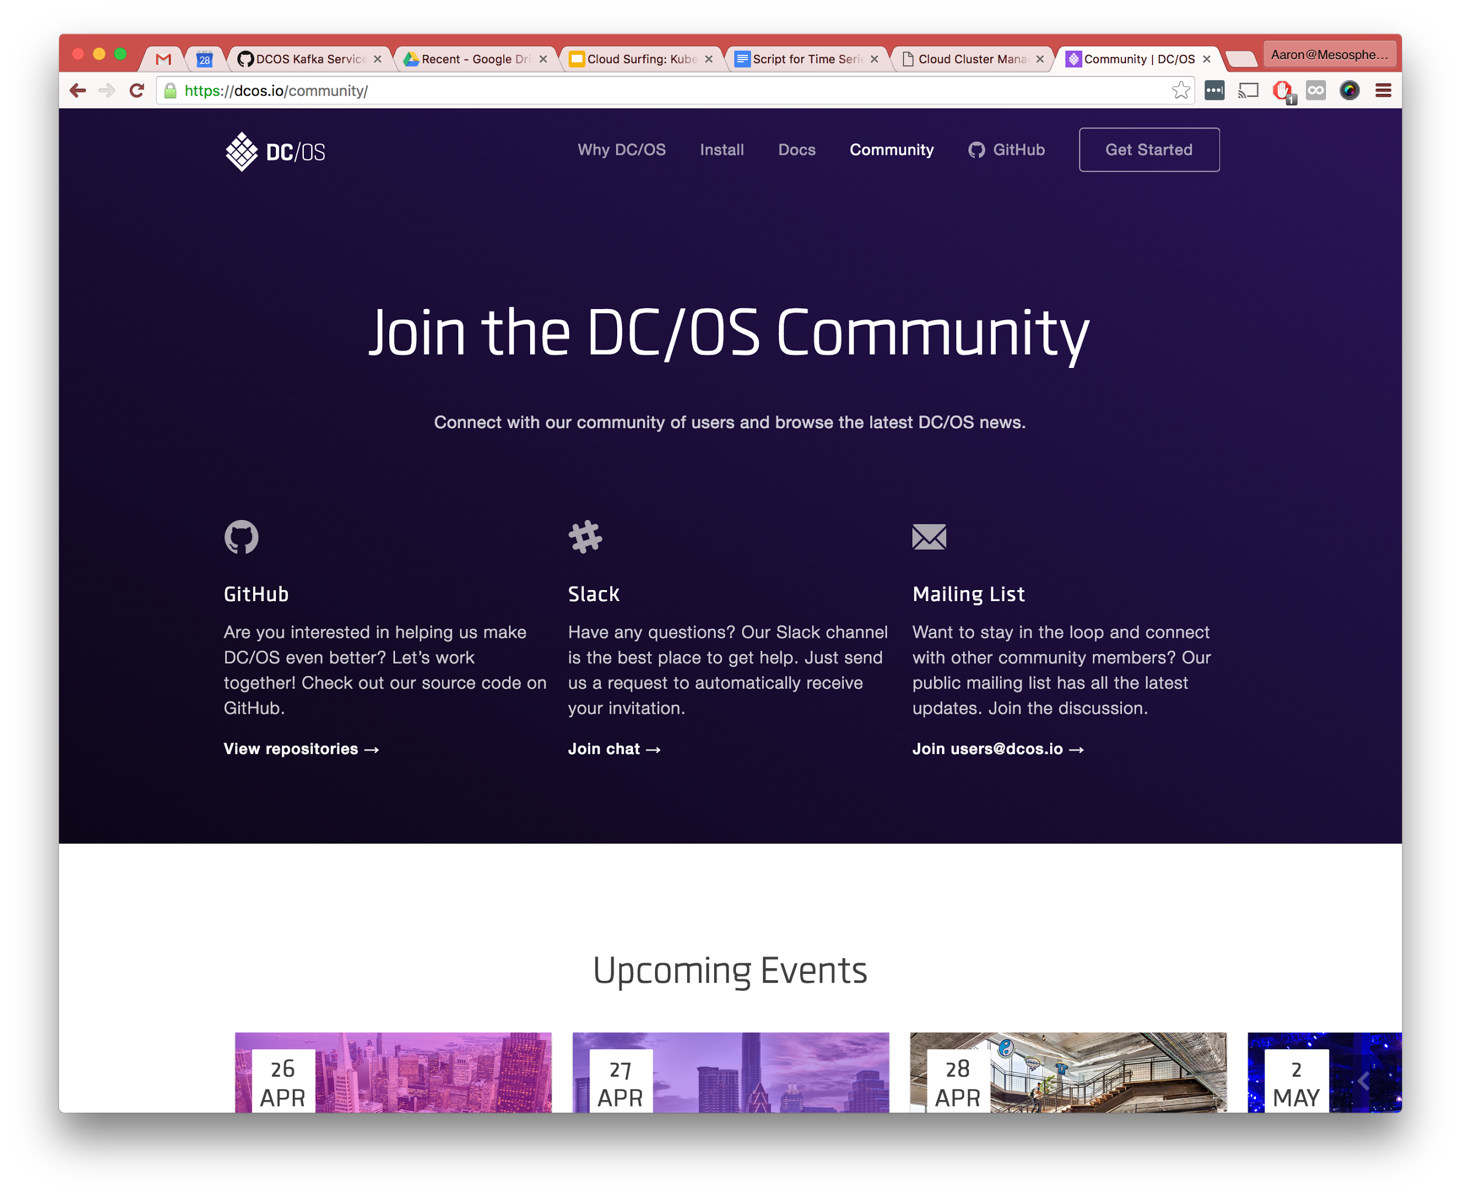

Slide 27
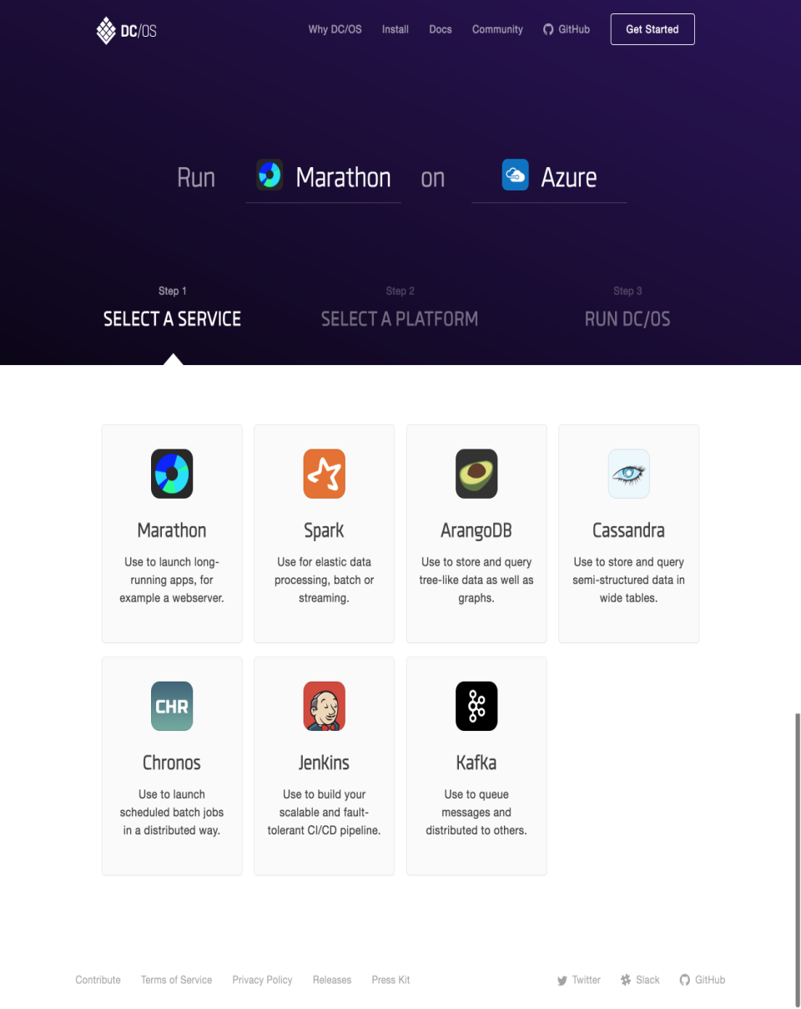
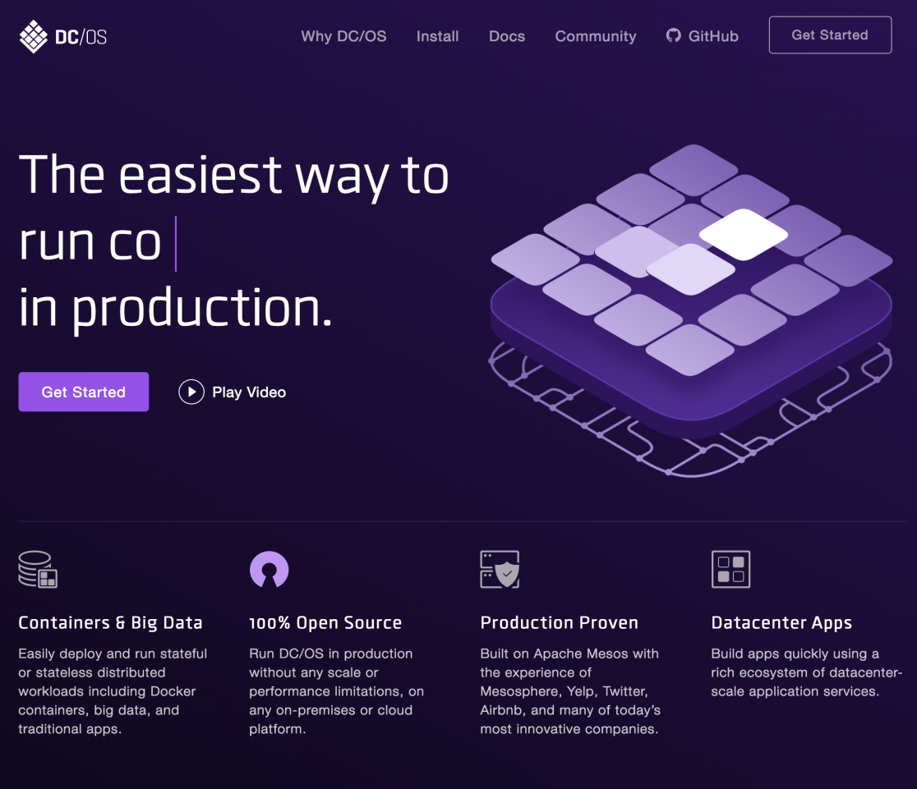
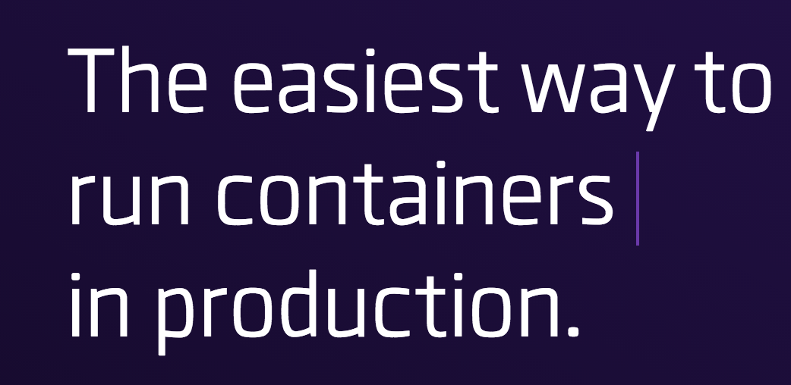
DCOS.io

Slide 28
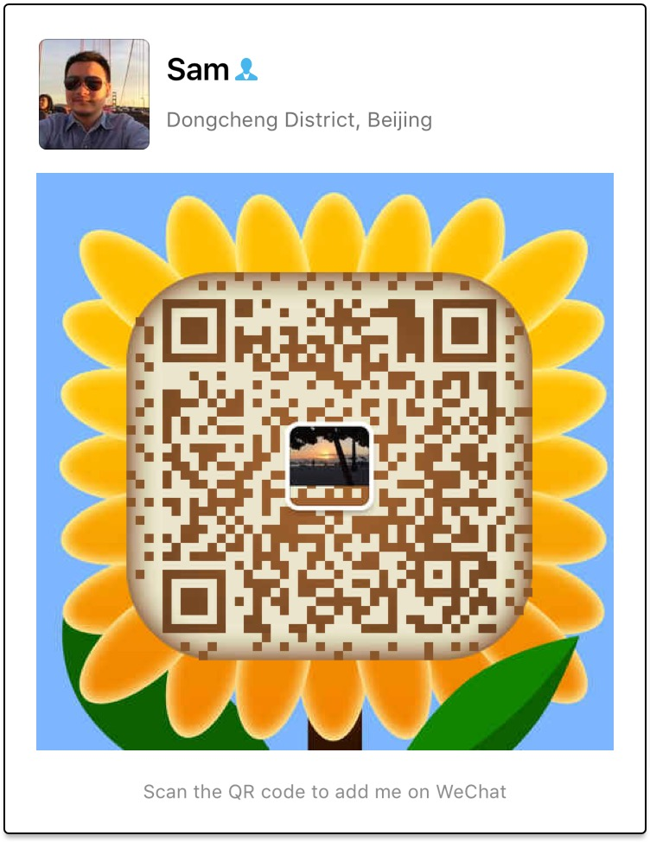
谢谢
Q&A

